Slide 1

Fitness Exercise App
Sahil Shetty-20104122
Pranil Patil -20104121
Akash Patil-20104075
Project Guide
Prof. Sonal Balpande
Notes:
1

Slide 2
Contents
Introduction
Objectives
Scope
Literature Survey
Proposed System
Project Outcomes
Block Diagram
Use Case/DFD
Technology Stack
Suggestions in Review-1
Result and Discussion
Conclusion and Future Scope
References

Slide 3
1. Introduction
The fitness industry has been continuing to grow year after year with more individuals becoming health conscious. Today’s apps currently don’t have a simple all in one application in helping users progress in the gym. As a result, a website has been developing in this project using ReactJs, to help users their gym life and the user will be able to track workouts for a particular day with the ability to add exercises
Problem Identified :
Users need a website to track their workout and create a routine that can maximize their workout.
Solution Proposed :
The user will be able to track workouts for a particular day with the ability to add exercises. Each exercise can have a corresponding detail of sets and information about how to do the corresponding exercise.
Notes:
3

Slide 4
2. Objectives
To empower people to create healthy training habits
To make best use of gym equipment and resources through workout videos.
To add new exercises in their workout plan
To build a user friendly website.
To reduce paper work and cost.
Notes:
4

Slide 5
3. Scope
Can be used to track workouts.
Can be used to add exercises to workouts and their corresponding sets.
Can be used to understand exercise through multiple videos.
Can be used to reduce paper work.
Notes:
5

Slide 6
4.Literature survey
As the most downloaded type of mobile health applications (mHealth apps), fitness apps can help people manage their nutritional intake, assist their participation in fitness and physical activities, and promote a healthy lifestyle. Therefore, these apps are gradually occupying the commercial mobile app market.Numerous studies have implemented empirical protocols to verify the results of using fitness apps for improving the level of physical activity and/or diet in users . However, from the academic side, it is still a novel and young area of research.

Slide 7
5. Proposed System
Workout videos:
User can refer to various workout plans to help them understand the exercises.
Similar exercise:
User can see similar exercise to their current plan with the help of API
Equipments:
User can view the exercises related to the equipment they own and add to their plan.
Notes:
7

Slide 8
6. Outcome of Project
User can search for respective exercises.
Using API, users are recommended similar exercise.
Exercise videos users can refer to.
Makes your workout plan easier and improves the quality of your life.
Notes:
8

Slide 9
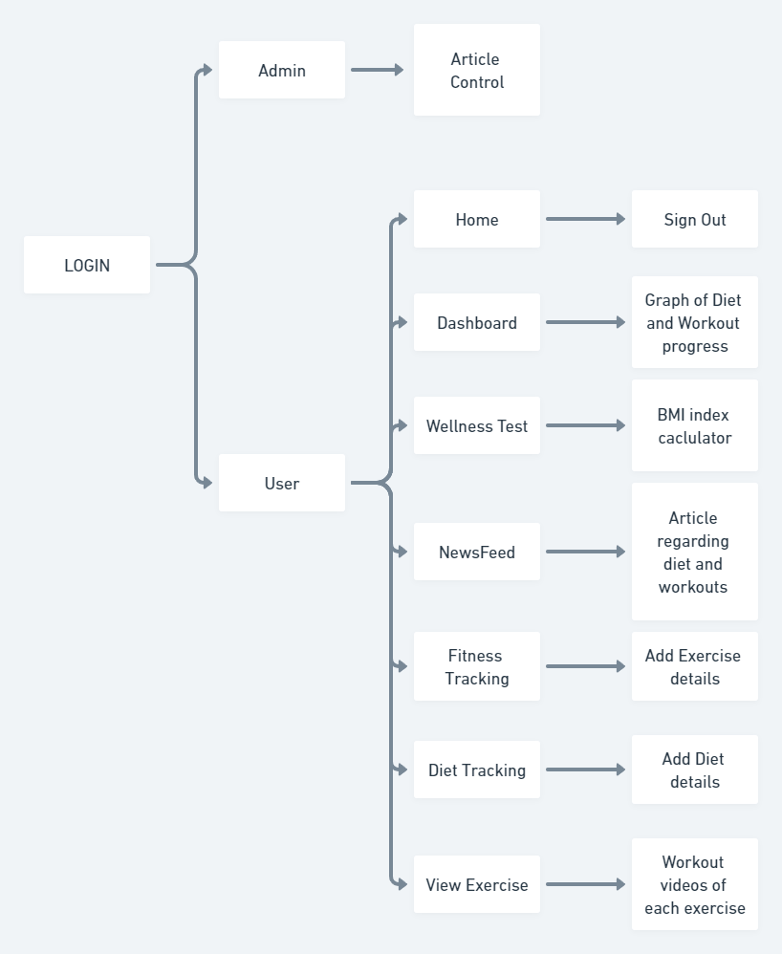
7. BLOCK DIAGRAM

Slide 10
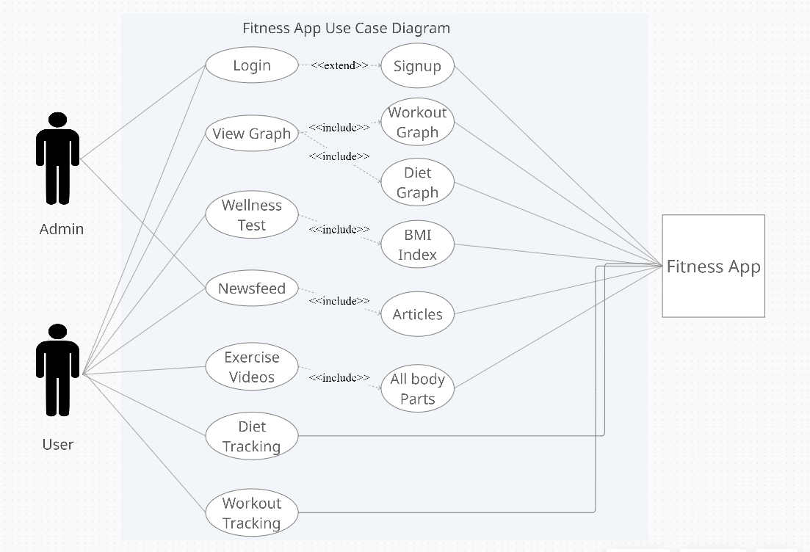
8. Use Case Diagram

Slide 11





9. Technology Stack
Html5
Css
Js
Php
Phpmyadmin
Notes:
11

Slide 12
10. Suggestions in Review-1
Suggestion in Review-1 is alignment in input field in wellness test.
Suggestion in Review-1 is add exercise library API.
Notes:
12

Slide 13
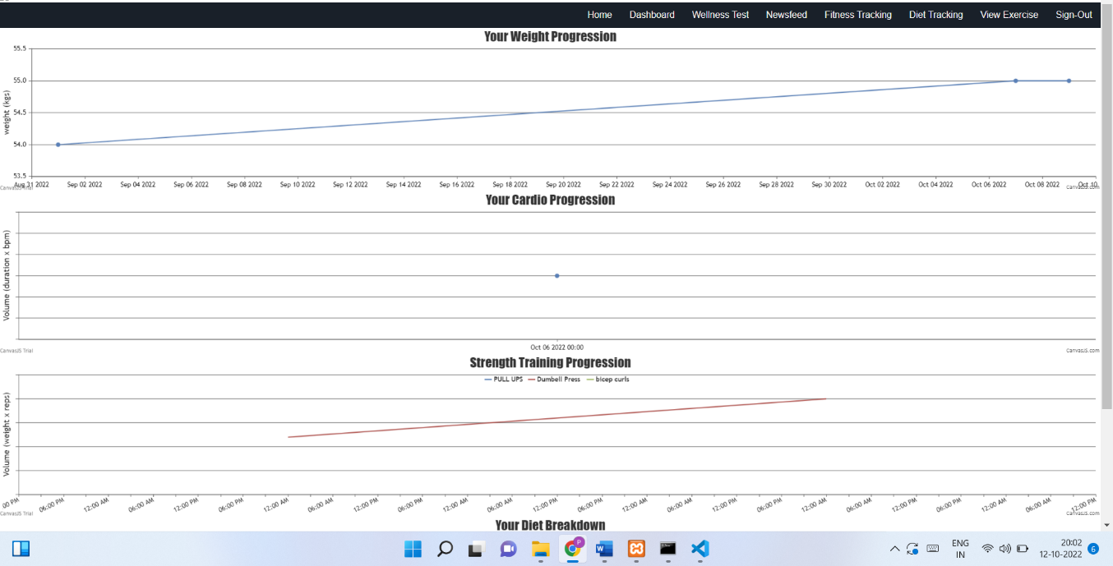
11. Result and Discussion
Notes:
13

Slide 14
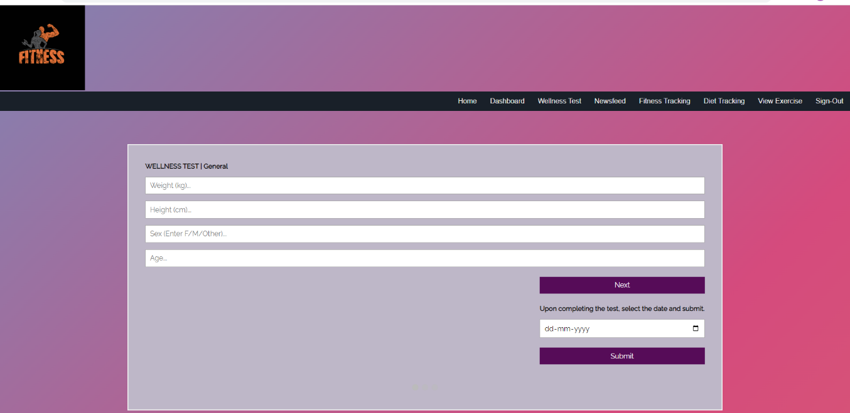
11. Result and Discussion
Notes:
14

Slide 15
12. Conclusion and Future Scope
Thus, the Fitness Exercise App will provide a user friendly and easy interface to operate. User can Manage there fitness goals by tracking there daily diet charts and analyse via graph .User can also get an idea what Exercises we want to do in sessions by measuring all reps and progress .App provide seamless and manageable experience to get better results in there daily routine . Therefore, our aim is to provide user a very easy access to the app managing the fitness goals.
Notes:
15

Slide 16
Thank You...!!
Notes:
16

